Slide 1



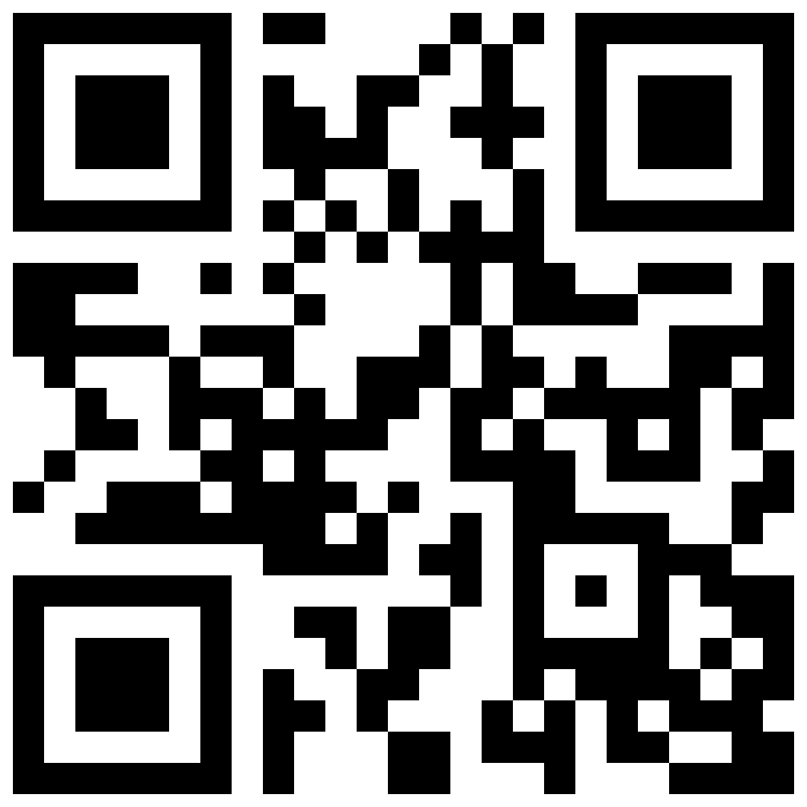
STUDENT ESSAY CONTEST
The 8th annual Page Center Awards will be
streamed at 4 p.m. ET on March 25, 2024.
awards.thepagecenter.org | #PageCenterAwards
HOW IT WORKS:
Register for the 2024 Page Center Awards.
Watch the program on March 25 or
watch the recording shortly after.
Choose one of the honorees.
Honorees will share remarks and participate in a Q&A session at the event.
Submit an essay (300-350 words) about the event and the honoree with a reflection on the honoree’s segment by April 3.
Ursula Burns,
Teneo and XEROX
Sanjay
Gupta
CNN
Kelly McGinnis
Levi Strauss & Co.
REGISTER
HERE
Winners will receive a $250 prize and winning essays will be shared with honorees and posted on
the Page Center blog.
More info visit: awards.thepagecenter.org

