Slide 1


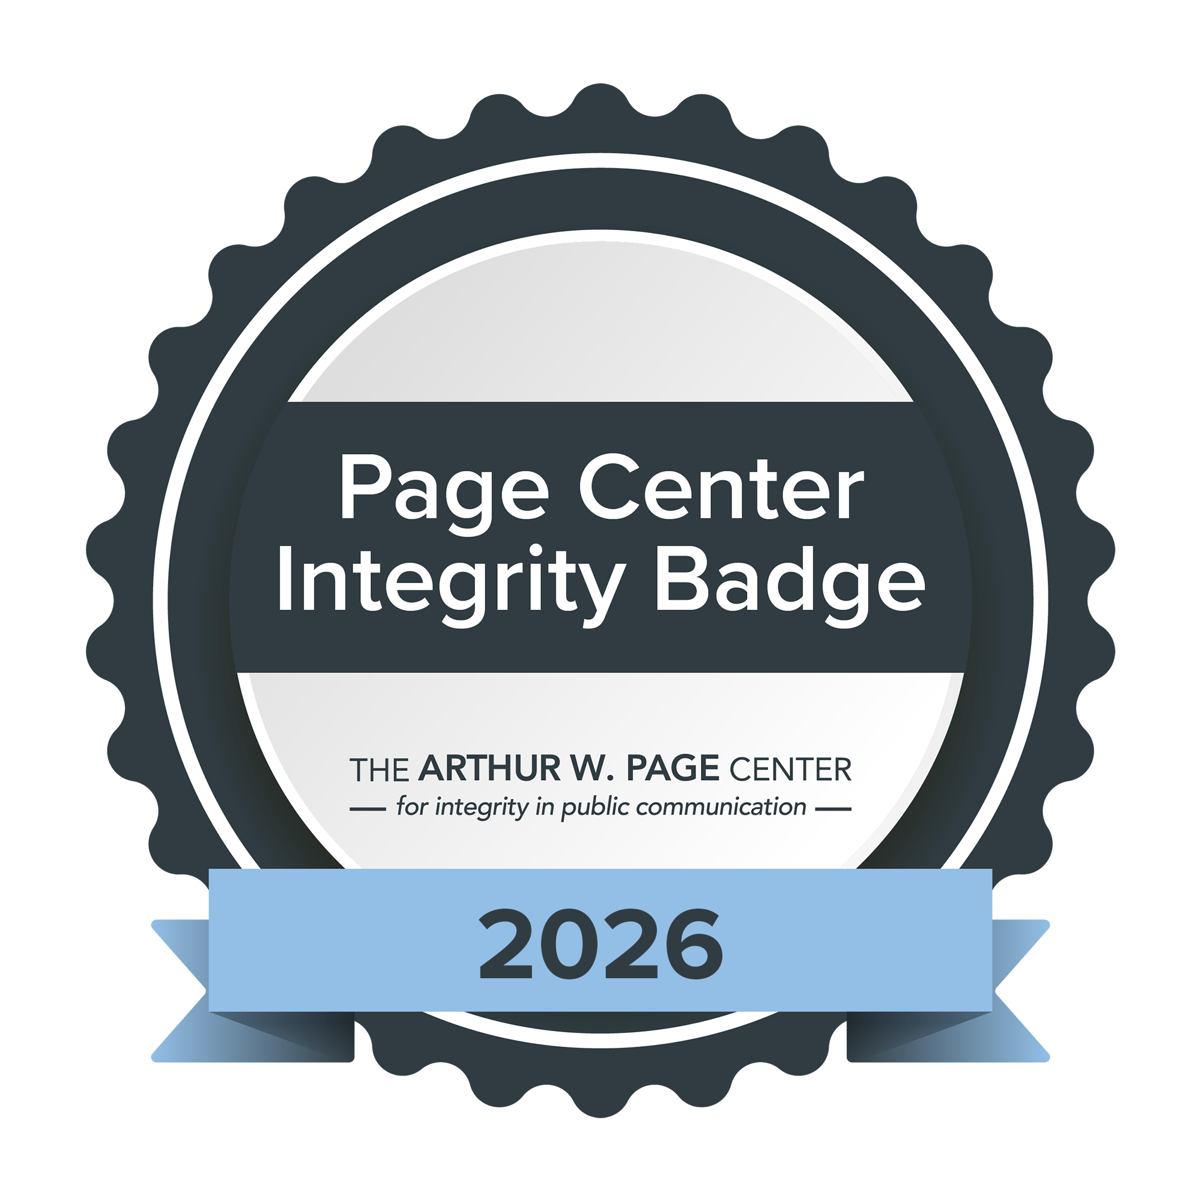
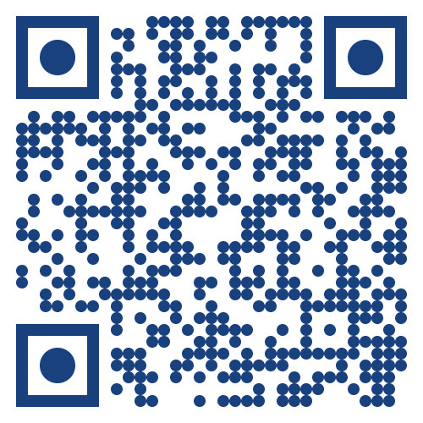
THE PAGE CENTER AWARDS ETHICS TRAINING
HOW THE MODULE WORKS
1. Register for the Page Center Ethics Training Modules.
2. Complete Lesson #1 before watching the event.
3. Watch the awards on the Page Center website or YouTube channel.
4. Return to the module to
complete Lesson #2.
5. When both lessons are complete, students will be eligible for a Page Center Integrity Badge from Credly.
Get started at:
pagecentertraining.psu.edu

